Slide 1
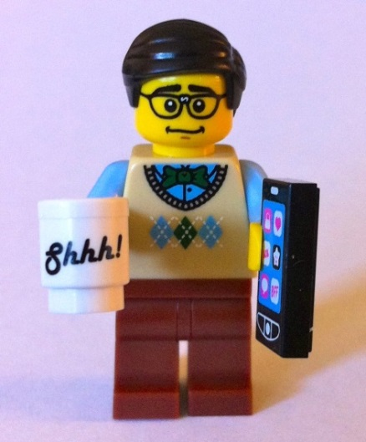
What do Librarians do?
Enquiries
Finding books
Computers/Printers
Cataloguing
Keywords
Classification
Acquisitions
Deciding what to buy
Ordering Books
Accounts/Invoices
New book preparation
Circulations
Loans, returns
Reservations
Sanctions
Reminders
Lost books
Book repair
Marketing
- Displays
Events
Clubs
Library Management
Behaviour
Signs
Shelving
Notes:
Things in bold are what pupil librarians can help with!

Slide 2

The important stuff
Duty starts at 1pm (lunch passes available)
Commit to one lunchtime per week
Turn up regularly (3 strikes and you’re out!)
Listen to your team leader on the day
Be prepared to help with a variety of tasks
If you cannot attend let me or Mrs Shah know in advance

Slide 3
Tasks
Working on the circulations desk (once trained)
Recommending good reads to others
Shelving – responsibility for a particular area
Writing book reviews (especially of new books)
Assisting with library promotions/events etc.
Creating displays
Modelling excellent behaviour in the Library
Improving / innovating services
Special projects

Slide 4
Book Promotions
Book Reviews on the catalogue
‘Reader-to-reader’ cards
Word of mouth recommendations
Posters around school?
New books promotional newsletter/leaflets?
Competitions or challenges
Special lunchtime events
during duty time

Slide 5

Rewards
Borrowing privileges – up to 5 loans/reservations
Badges!
First access to new stock to review new books
Opportunity to attend special events
Achieve Gold/Silver Library Awards
Make your mark on the Library!
Useful experience for your CV…

Slide 6
Awards
SILVER LIBRARY AWARD
Read and review 5 books (range of genres)
Regular attendance
Booklist / Bookmark
Accurate shelving
Understands / can explain library systems
Displays
GOLD LIBRARY AWARD
Maintains standard of silver award
Read and review 10 books (range of genres)
Takes initiative
Helps to organise events
Prepares stock for shelf
Desk duty unaided
Completes Special Project

Slide 7
Extended projects (examples)
Running a book club
Conducting pupil surveys
Organizing form book swaps
Creating book corners in classrooms
Producing genre guides
Creating a library video
Producing a library newsletter
Developing a guide for library users
….or, you might have your own ideas!

Slide 8
eQE
Check the pupil librarian page and your messages regularly so that you don’t miss meetings or training
Info like timetables will go on eQE
Events/promotions will be advertised via eQE

Slide 9
Conduct
If you are not on duty, please don’t crowd behind the library desk…
Make sure you set a good example when you are in the library (and reinforce library rules if you notice problems)
Have a polite, helpful, can-do attitude towards all library users
Reliability is extremely valued by staff!

Slide 10
What’s coming up?
Desk & Shelving training for new PLs
TUES 7th NOVEMBER at 2:00-2:25 (form time)
GROUP A – Desk training in Autumn term
GROUP B – Desk training in Spring term
PLUS: Timetabled programme for new PLs – weekly tasks/challenges

